Slide 1

22년 삼성 AI 전문가과정
6월 9일 목요일 3교시
장병탁
인공지능
18차시 : Language
서울대학교 컴퓨터공학부
담당 교수: 장병탁
Seoul National University
Byoung-Tak Zhang

Slide 2
Lecture Overview
인공지능
18차시 : Language
서울대학교 컴퓨터공학부
담당 교수: 장병탁
Seoul National University
Byoung-Tak Zhang

Slide 3
Introduction: Language
Why we want the agents to be able to do natural language processing (NLP)?
To communicate with humans in a natural way
To learn information from written language
To advance the scientific understanding of languages and language use
Natural Language Processing
How to make use of the human knowledge expressed in natural language?
Processing, i.e. analyzing and generating, sentences and texts
Information seeking tasks: text classification, information retrieval
Understanding the grammar (syntax), meaning (semantics), and use (pragmatics) of human language
Communication tasks: Machine translation, speech recognition, dialogue systems

Slide 4

Language Understanding & Conversation
Cleverbot
Google Assistant
<출처> https://www.youtube.com/watch?v=WnzlbyTZsQY

Slide 5
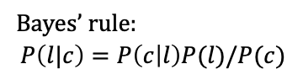
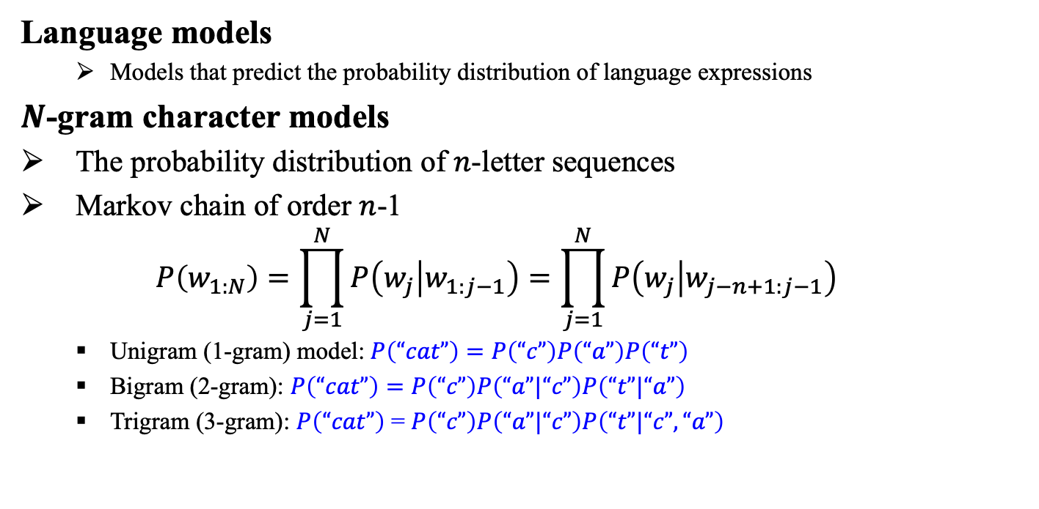
Language Models
Language models
Models that predict the probability distribution of language expressions
$N$-gram character models
The probability distribution of $n$-letter sequences
Markov chain of order $n$-1
$$P\left(w_{1:N}\right)=\prod_{j=1}^{N}{P\left(w_{j} | w_{1:j−1}\right)}=\prod_{j=1}^{N}{P\left(w_{j} | w_{j−n+1:j−1}\right)}$$
Unigram (1-gram) model:$P\left(“cat”\right)=P\left(“c”\right)P\left(“a”\right)P\left(“t”\right)$
Bigram (2-gram): $P\left(“cat”\right)=P\left(“c”\right)P\left(“a”|“c”\right)P\left(“t”|“a”\right)$
Trigram (3-gram): $P\left(“cat”\right)$ = $P\left(“c”\right)P\left(“a”|“c”\right)P\left(“t”|“c”,“a”\right)$
Bayes’ rule:
$$P\left(l|c\right)=P\left(c | l\right)P(l)/P(c)$$

Slide 6
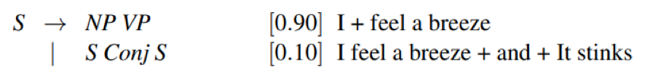
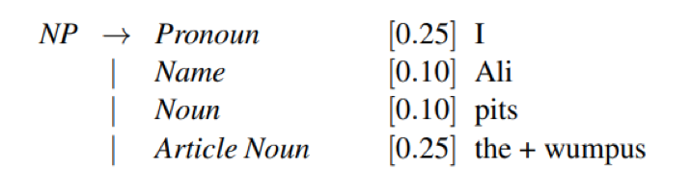
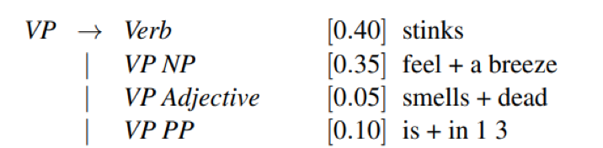
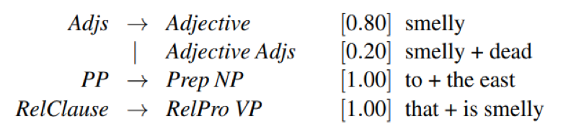
Probabilistic Context-Free Grammar (PCFG)
출처: Stuart J. Russell and Peter Norvig (2021). Artificial Intelligence: A Modern Approach (4rd Edition). Pearson

Slide 7
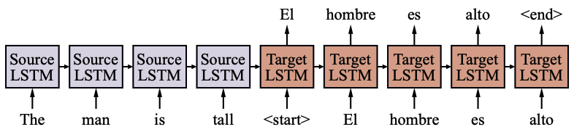
Sequence-to-Sequence Models
Sequence-to-sequence model for machine translation (MT)
Translate a sentence from a source language to a target language
Challenges
Words are not one-to-one mapped
“caballo de mar” to “seahorse”
Word reordering
English: subject is usually at the start
Fijian: subject is usually at the end
Generation of each target word is conditional on the entire source sentence and all previously generated target words
출처: Stuart J. Russell and Peter Norvig (2021). Artificial Intelligence: A Modern Approach (4rd Edition). Pearson

Slide 8
Outline (Lecture 18)
18.1 Language Models ...............................................
18.2 Grammar .............................................................
18.3 Parsing ................................................................
18.4 Augmented Grammars .......................................
18.5 Complications of Real Natural Language ..........
18.6 Word Embeddings ..............................................
18.7 Recurrent Neural Networks for NLP ..................
18.8 Sequence-to-Sequence Models ...........................
18.9 The Transformer Architecture ............................
18.10 Natural Language Tasks ...................................
Summary ....................................................................
8
13
18
20
24
28
31
34
38
42
51

Slide 9
18.1 Language Models

Slide 10
18.1 Language Models (1/4)
Language models
Models that predict the probability distribution of language expressions
$N$-gram character models
The probability distribution of $n$-letter sequences
Markov chain of order $n$-1
$$P\left(w_{1:N}\right)=\prod_{j=1}^{N}{P\left(w_{j} | w_{1:j−1}\right)}=\prod_{j=1}^{N}{P\left(w_{j} | w_{j−n+1:j−1}\right)}$$
Unigram (1-gram) model:$P\left(“cat”\right)=P\left(“c”\right)P\left(“a”\right)P\left(“t”\right)$
Bigram (2-gram): $P\left(“cat”\right)=P\left(“c”\right)P\left(“a”|“c”\right)P\left(“t”|“a”\right)$
Trigram (3-gram): $P\left(“cat”\right)$ = $P\left(“c”\right)P\left(“a”|“c”\right)P\left(“t”|“c”,“a”\right)$
Bayes’ rule:
$$P\left(l|c\right)=P\left(c | l\right)P(l)/P(c)$$

Slide 11
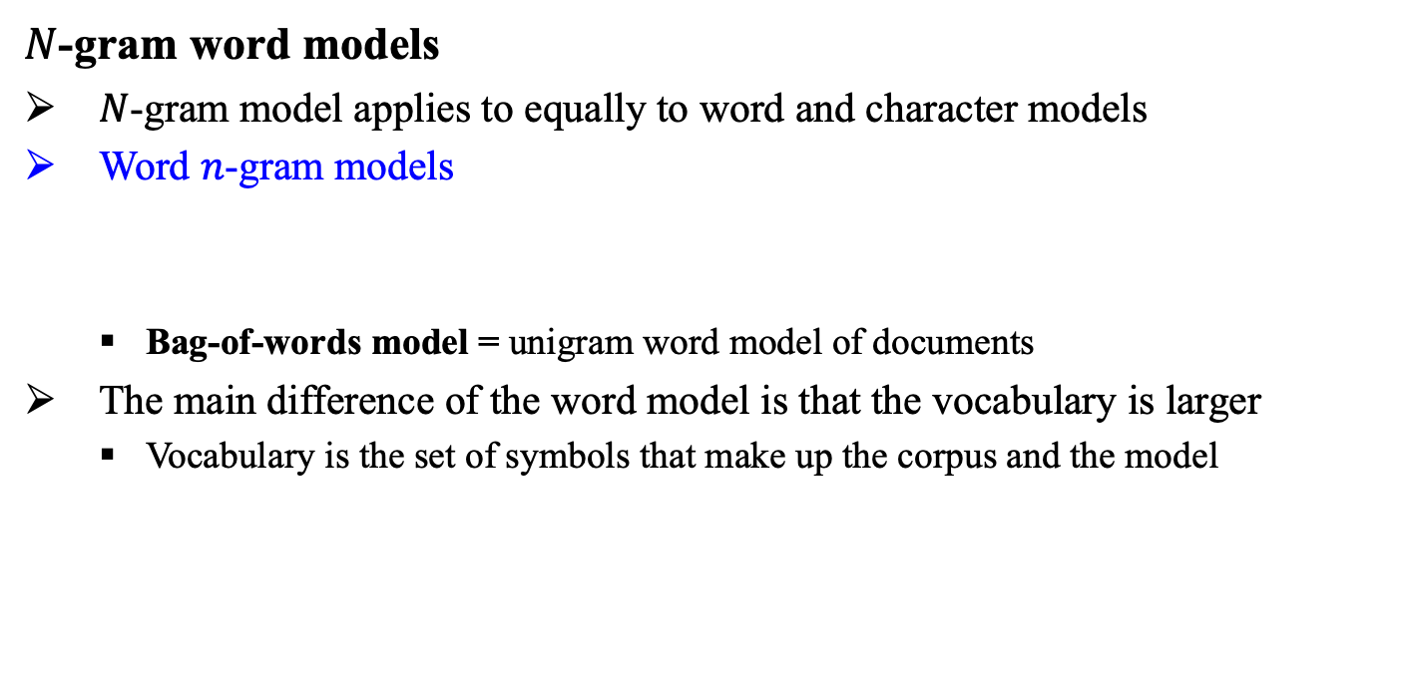
18.1 Language Models (2/4)
$N$-gram word models
$N$-gram model applies to equally to word and character models
Word $n$-gram models
Bag-of-words model = unigram word model of documents
The main difference of the word model is that the vocabulary is larger
Vocabulary is the set of symbols that make up the corpus and the model
$$P\left(“I love you” \right)=P\left(“love”|“I” \right)P\left(“you”|“love”\right)$$

Slide 12
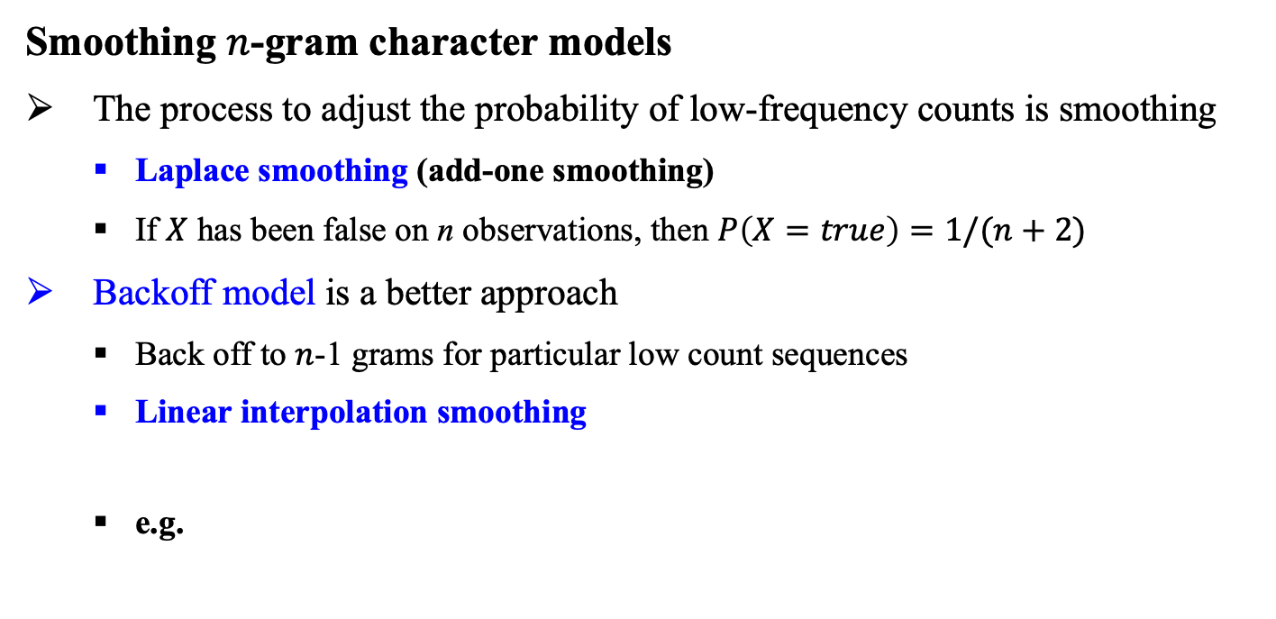
18.1 Language Models (3/4)
Smoothing $n$-gram character models
The process to adjust the probability of low-frequency counts is smoothing
Laplace smoothing (add-one smoothing)
If $X$ has been false on n observations, then $P\left(X=true\right)=1/(n+2)$
Backoff model is a better approach
Back off to $n$-1 grams for particular low count sequences
Linear interpolation smoothing
e.g.
$$\hat{P}\left(“t”|”ca”\right)=λ3P\left(“t”|“ca” \right)+λ2P\left(“t”|“a”\right)+λ1P\left(“t”\right)$$

Slide 13
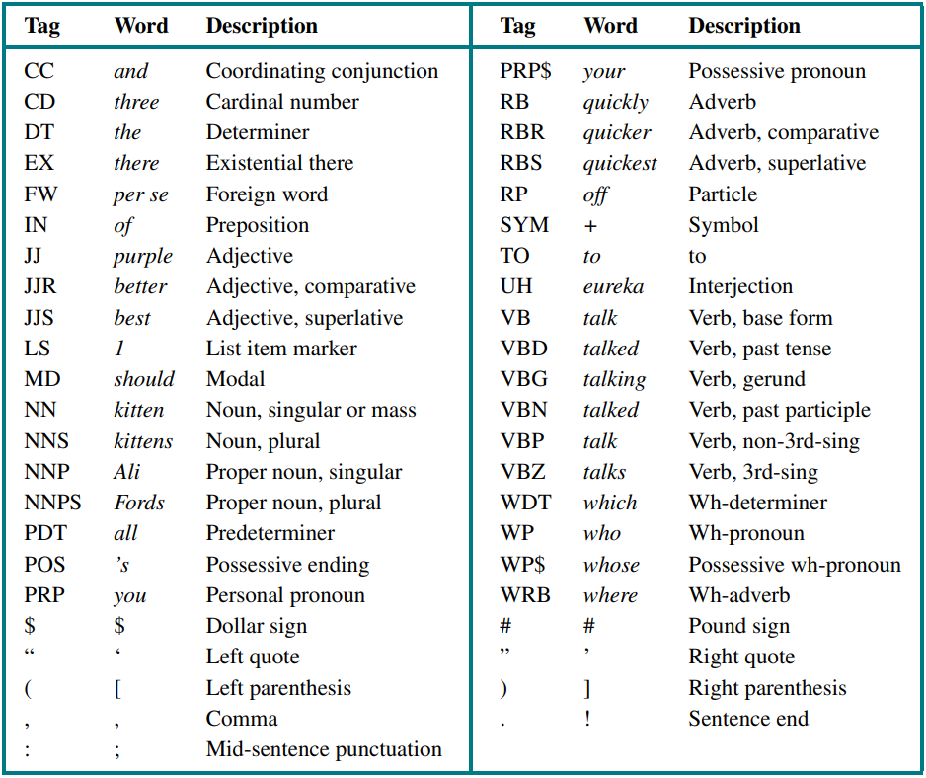
18.1 Language Models (4/4)
Part-of-speech (POS) tagging
Lexical category or tag
noun, verb, adjective, and so on
The task of assigning a part of speech to each word in a sentence
Hidden Markov model (HMM)
출처: Stuart J. Russell and Peter Norvig (2021). Artificial Intelligence: A Modern Approach (4rd Edition). Pearson

Slide 14
18.2 Grammar

Slide 15
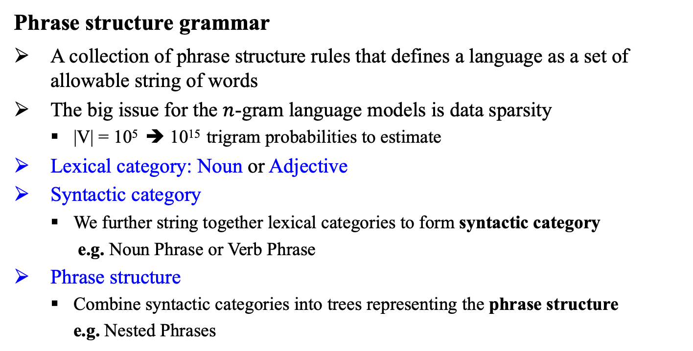
18.2 Grammar (1/4)
Phrase structure grammar
A collection of phrase structure rules that defines a language as a set of allowable string of words
The big issue for the $n$-gram language models is data sparsity
|V| = 10⁵ ➔ 10¹⁵ trigram probabilities to estimate
Lexical category: Noun or Adjective
Syntactic category
We further string together lexical categories to form syntactic category
e.g. Noun Phrase or Verb Phrase
Phrase structure
Combine syntactic categories into trees representing the phrase structure
e.g. Nested Phrases

Slide 16
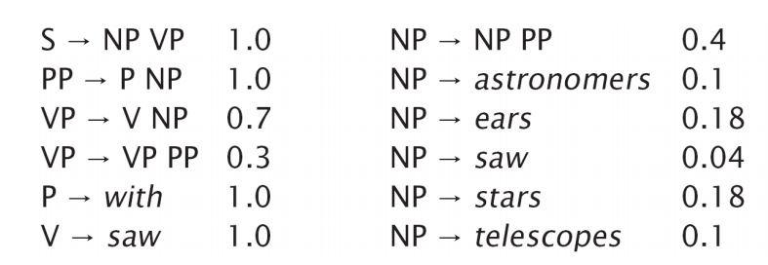
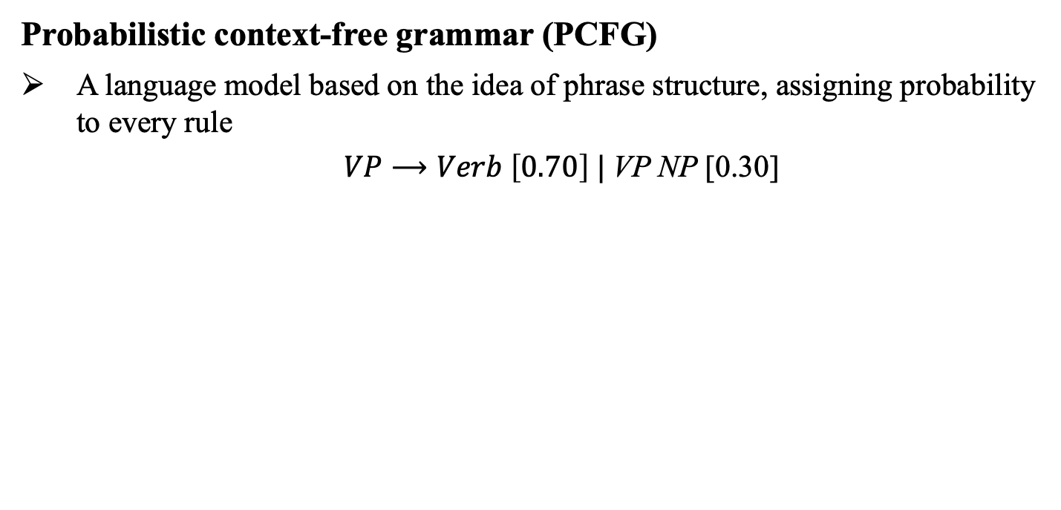
18.2 Grammar (2/4)
Probabilistic context-free grammar (PCFG)
A language model based on the idea of phrase structure, assigning probability to every rule
$VP⟶Verb \left[0.70\right] |$VP NP [0.30]

Slide 17
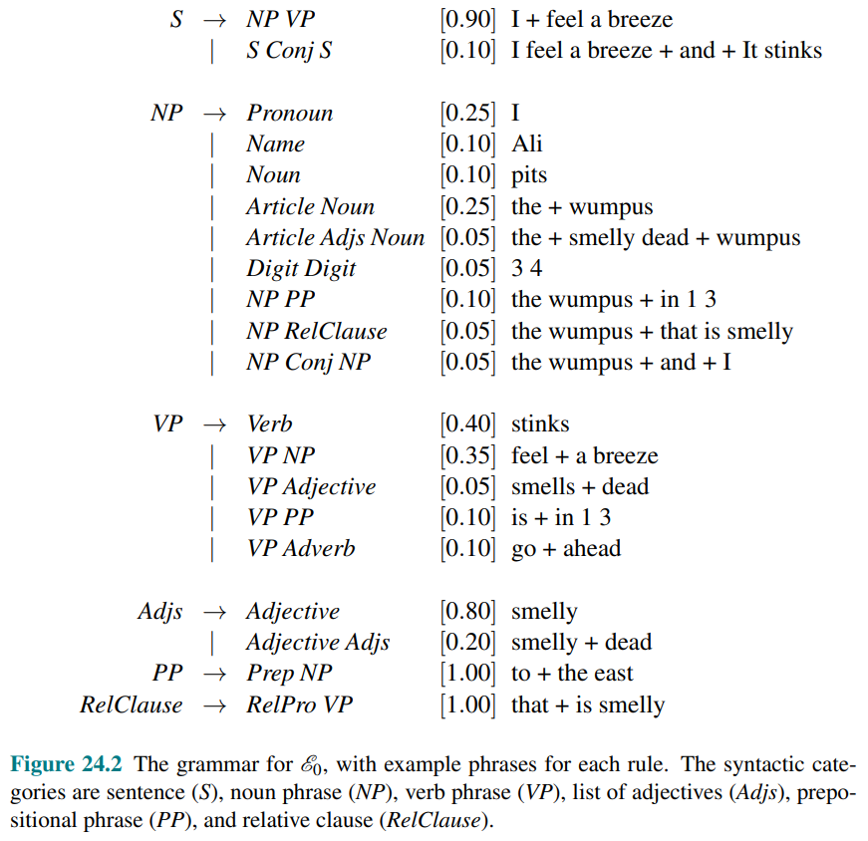
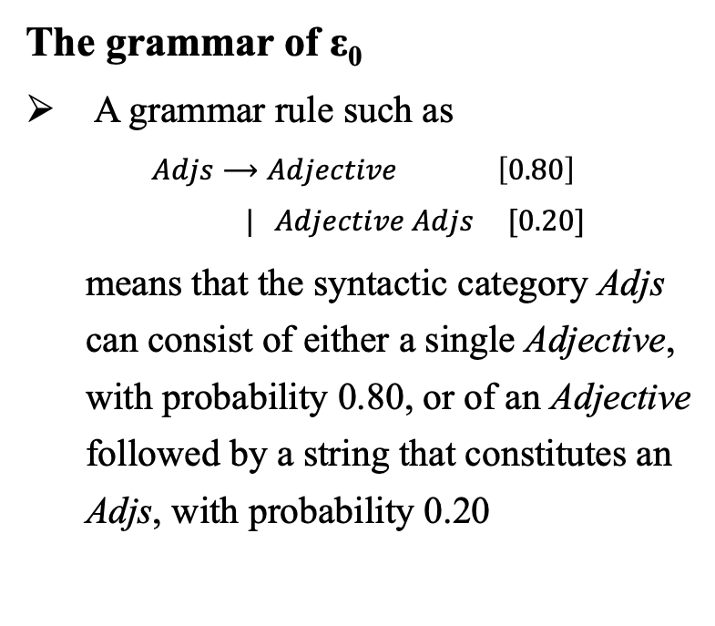
18.2 Grammar (3/4)
The grammar of ε₀
A grammar rule such as
$Adjs⟶Adjective \left[0.80\right]$
$| Adjective Adjs [0.20]$
means that the syntactic category Adjs can consist of either a single Adjective, with probability 0.80, or of an Adjective followed by a string that constitutes an Adjs, with probability 0.20
출처: Stuart J. Russell and Peter Norvig (2021). Artificial Intelligence: A Modern Approach (4rd Edition). Pearson

Slide 18
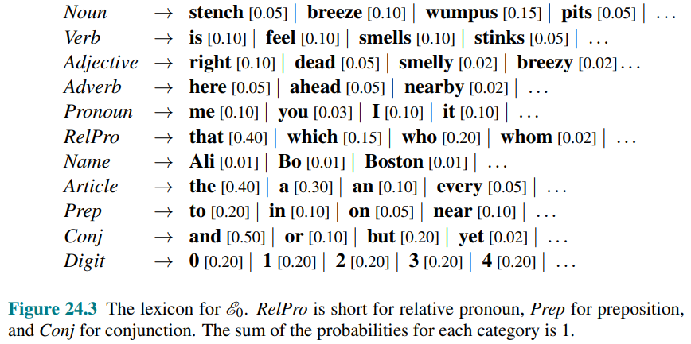
18.2 Grammar (4/4)
The lexicon of ε₀
A list of allowable words
출처: Stuart J. Russell and Peter Norvig (2021). Artificial Intelligence: A Modern Approach (4rd Edition). Pearson

Slide 19
18.3 Parsing

Slide 20
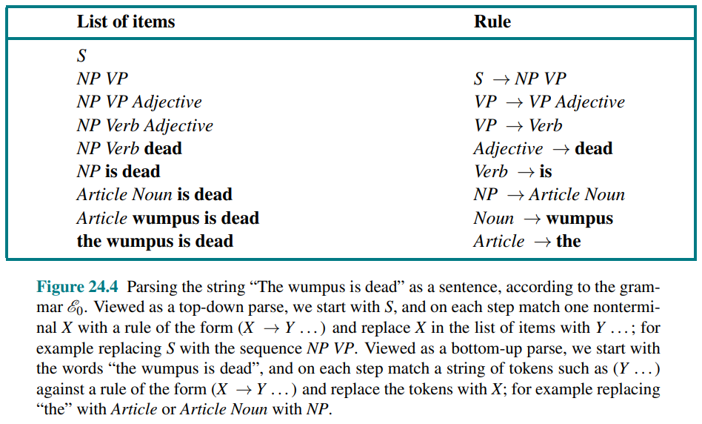
18.3 Parsing (1/1)
Parsing
The process of analyzing a string of words to uncover its phrase structure, according to the rules of a grammar
출처: Stuart J. Russell and Peter Norvig (2021). Artificial Intelligence: A Modern Approach (4rd Edition). Pearson

Slide 21
18.4 Augmented Grammars

Slide 22
18.4 Augmented Grammars (1/3)
Augmented grammars
The nonterminals are not just atomic symbols like Pronoun or NP, but are structured representations.
Make finer-grained distinctions about which sentences are more likely.
Construct a representation of the semantics of a phrase.
e.g.
The noun phrase “I” could be represented as NP(Sbj,1S,Speaker), which means “a noun phrase that is in the subjective case, first person singular, and whose meaning is the speaker of the sentence.”
In contrast, “me” would be represented as NP(Obj,1S,Speaker), marking the fact that it is in the objective case

Slide 23
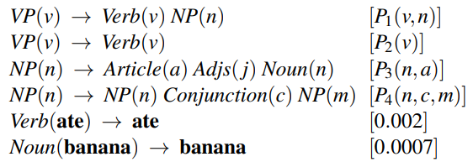
18.4 Augmented Grammars (2/3)
Lexicalized PCFGs
Syntactic analysis can’t estimate the relation between phrases
“eat a banana” vs. “eat a bandana”
Lexicalized PCFGs
The probabilities for a rule depend on the relationship
Augmented grammar: A category is augmented with the head variable
The sentence will have the form of a definite clause, so the result is called a definite clause grammar (DCG).
출처: Stuart J. Russell and Peter Norvig (2021). Artificial Intelligence: A Modern Approach (4rd Edition). Pearson

Slide 24
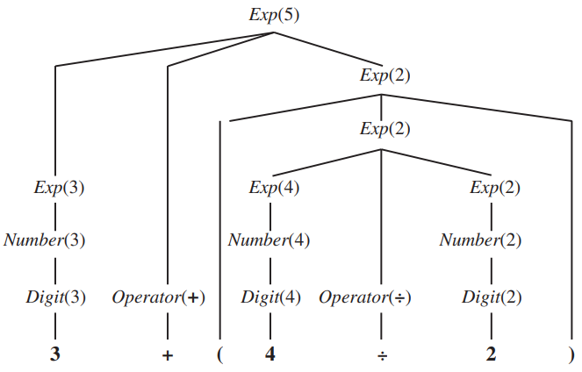
18.4 Augmented Grammars (3/3)
Semantic interpretation
Semantics of arithmetic expressions
Parse tree with semantic interpretations for the string “3 + (4 ÷ 2)”
출처: Stuart J. Russell and Peter Norvig (2021). Artificial Intelligence: A Modern Approach (4rd Edition). Pearson

Slide 25
18.5 Complications of Real
Natural Language

Slide 26
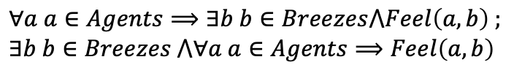

18.5 Complications of Real Natural Language (1/3)
Quantification
“Every agent feels a breeze.”
Is there one breeze that is felt by all the agents, or does each agent feel a separate personal breeze?
Pragmatics
Completing the interpretation by adding context-dependent information about the current situation
“I am in Boston today,”
both “I” and “today” are indexicals (phrases that refer directly to the current situation)
Interpreting the speaker’s intent
$∀a a∈Agents⟹∃b b∈Breezes⋀Feel\left(a,b\right) ;$
$$∃b b∈Breezes ⋀∀a a∈Agents⟹Feel\left(a,b\right)$$

Slide 27
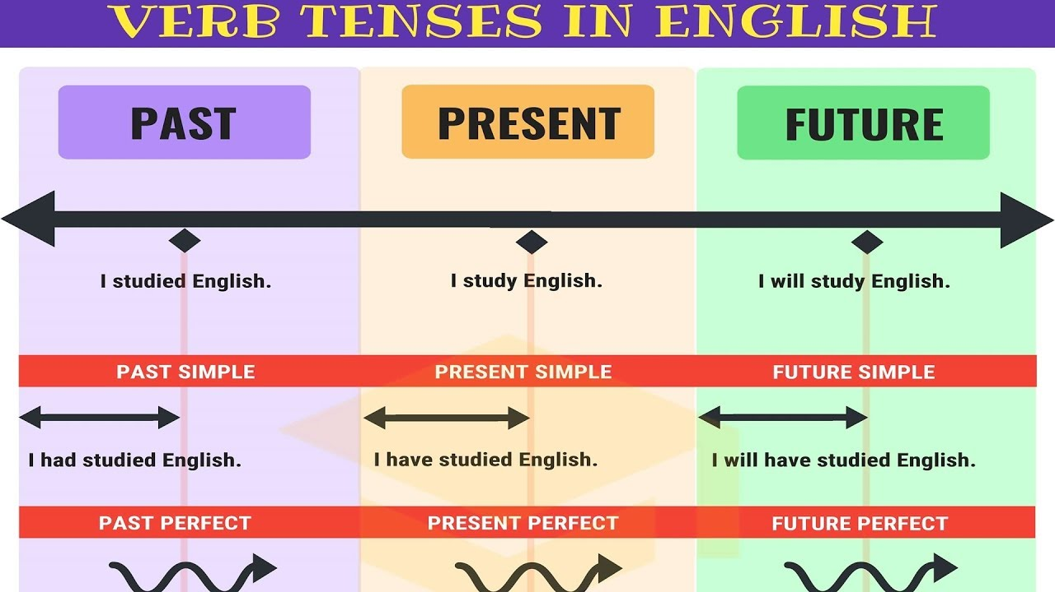
18.5 Complications of Real Natural Language (2/3)
Long-distance dependencies
Distance between the gap and the NP it refers to can be arbitrarily long
“Who did the agent tell you to give the gold to?”
Gap refers to “Who,” which is 11 words away
Time and tense
출처: ESL Learning English

Slide 28
18.5 Complications of Real Natural Language (3/3)
Ambiguity
Lexical ambiguity: a word has more than one meaning
“back” can be an adverb (go back), an adjective (back door), a noun (the back of the room), a verb (back a candidate), or a proper noun (a river in Nunavut, Canada)
Syntactic ambiguity: phrase that has multiple parses
“I smelled a wumpus in 2, 2” modifies noun or verb
Semantic ambiguity
Ambiguity between literal and figurative meanings
“Chrysler announced a new model,” we do not interpret it as saying that companies can talk

Slide 29
18.6 Word Embeddings

Slide 30
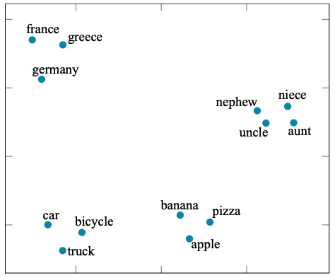
18.6 Word Embeddings (1/2)
Word embedding
A low-dimensional vector representing a word
Learned automatically from the data
Clusters for country, transportation, food, …
i.e. similar words have similar vectors
Using word embedding vectors rather than one-hot encodings is helpful in deep learning NLP tasks
WORD2VEC, GloVe (Global Vectors), FASTTEXT
출처: Stuart J. Russell and Peter Norvig (2021). Artificial Intelligence: A Modern Approach (4rd Edition). Pearson

Slide 31
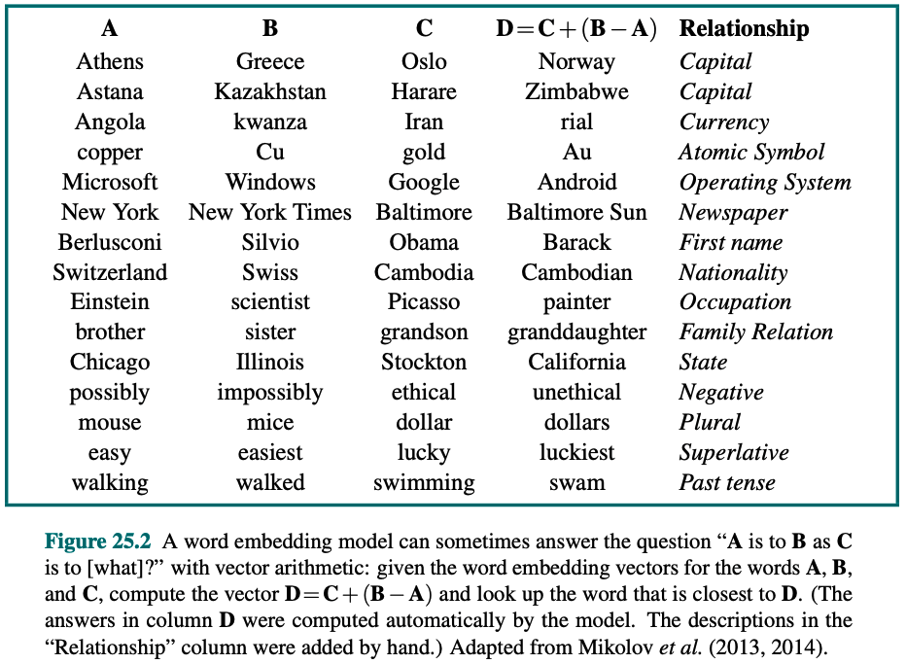
18.6 Word Embeddings (2/2)
Additional properties beyond mere proximity for similar words
“A is to B as C is to [what]?”
e.g.
Vector A: Athens and B for Greece
B – A : encode country/capital relationship
“Athens is to Greece as Oslo is to [what]?”
hypothesize B – A = D – C
D = C + (B – A)
Closest word with D: Norway
출처: Stuart J. Russell and Peter Norvig (2021). Artificial Intelligence: A Modern Approach (4rd Edition). Pearson

Slide 32
18.7 Recurrent Neural Networks
for NLP

Slide 33
18.7 Recurrent Neural Networks for NLP (1/2)
Language models with recurrent neural networks
Problem of fixed-size window
“Eduardo told me that Miguel was very sick so I took him to the hospital ”
him refers to Miguel and not Eduardo requires context that spans of 14-words
Problem of a feedforward network: asymmetry
Need to relearn for the appearance of him at other positions in the sentence because weights are different for each word position

Slide 34
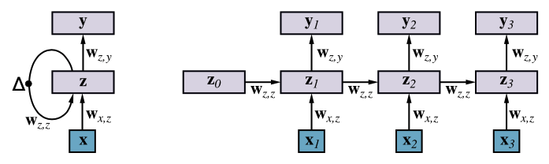
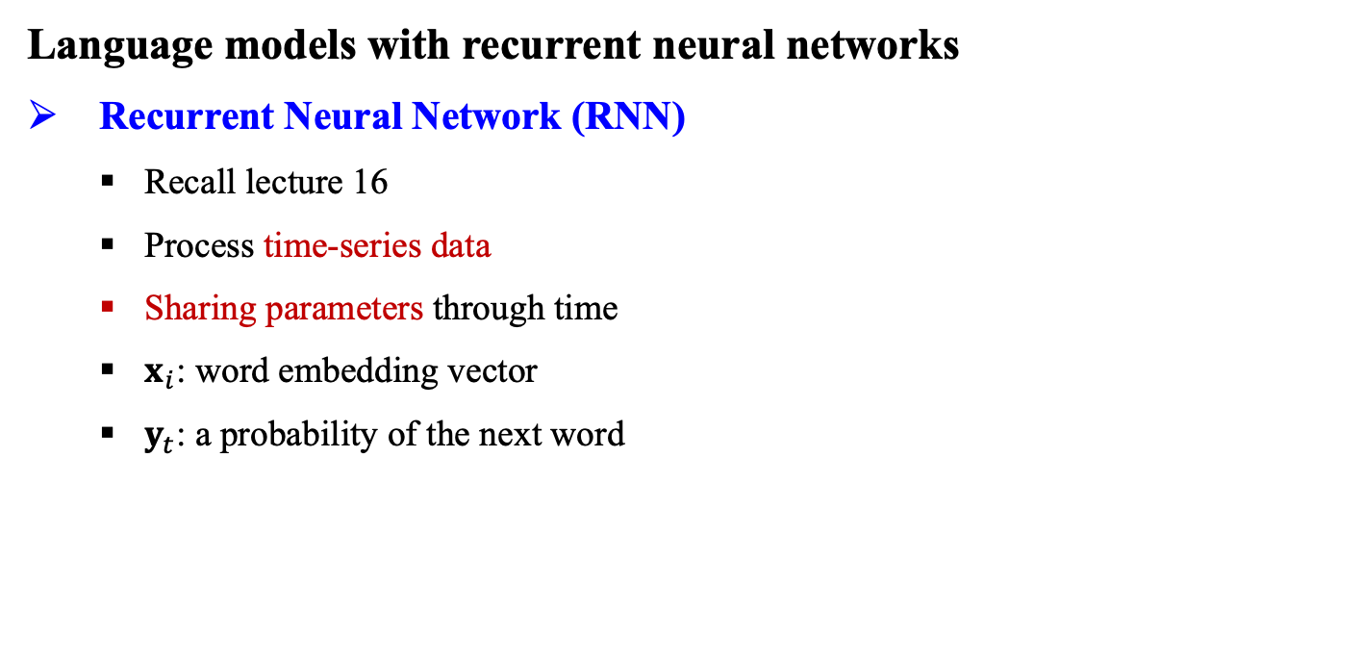
18.7 Recurrent Neural Networks for NLP (2/2)
Language models with recurrent neural networks
Recurrent Neural Network (RNN)
Recall lecture 16
Process time-series data
Sharing parameters through time
$x_{i}$: word embedding vector
$y_{t}$: a probability of the next word
출처: Stuart J. Russell and Peter Norvig (2021). Artificial Intelligence: A Modern Approach (4rd Edition). Pearson

Slide 35
18.8 Sequence-to-Sequence Models

Slide 36
18.8 Sequence-to-Sequence Models (1/3)
Sequence-to-sequence model for machine translation (MT)
Translate a sentence from a source language to a target language
Challenges
Words are not one-to-one mapped
“caballo de mar” to “seahorse”
Word reordering
English: subject is usually at the start
Fijian: subject is usually at the end
Generation of each target word is conditional on the entire source sentence and all previously generated target words
출처: Stuart J. Russell and Peter Norvig (2021). Artificial Intelligence: A Modern Approach (4rd Edition). Pearson

Slide 37
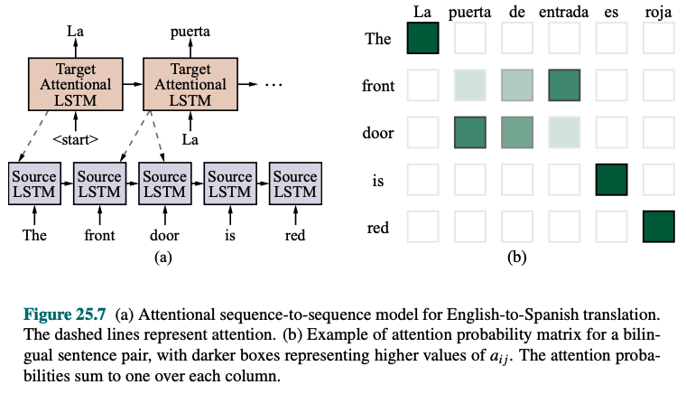
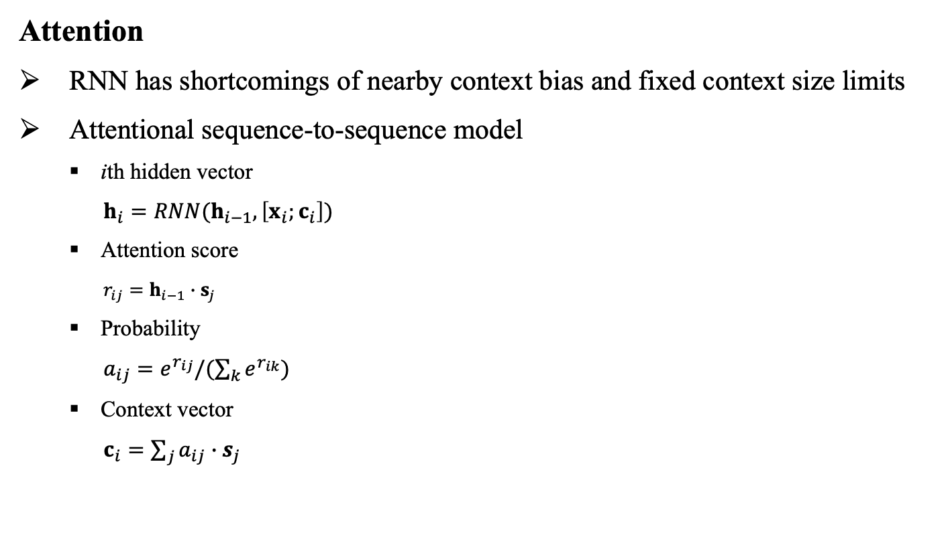
18.8 Sequence-to-Sequence Models (2/3)
Attention
RNN has shortcomings of nearby context bias and fixed context size limits
Attentional sequence-to-sequence model
ith hidden vector
$h_{i}=RNN(h_{i−1},\left[x_{i};c_{i}\right])$
Attention score
$r_{ij}=h_{i−1}∙s_{j}$
Probability
$a_{ij}=e^{r_{ij}}/(\sum_{k}{e^{r_{ik}}})$
Context vector
$c_{i}=\sum_{j}{a_{ij}∙s_{j}}$
출처: Stuart J. Russell and Peter Norvig (2021). Artificial Intelligence: A Modern Approach (4rd Edition). Pearson

Slide 38
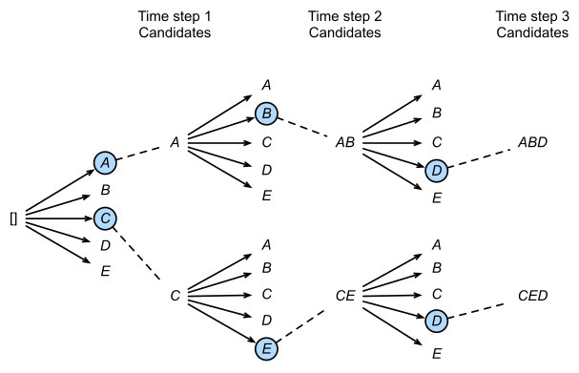
18.8 Sequence-to-Sequence Models (3/3)
Decoding
Generating target sentence corresponding to a source sentence
Greedy decoding
Select the highest probability word at each timestep
May not maximize the probability of the entire target sentence
Beam search (Recall Section 4.1.3)

Slide 39
18.9 The Transformer Architecture

Slide 40
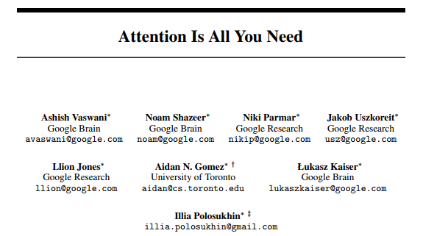
18.9 The Transformer Architecture (1/3)
Self-attention
Each sequence of hidden states also attends to itself
The source to the source, and the target to the target
Allows the model to additionally capture long-distance context within each sequence

Slide 41
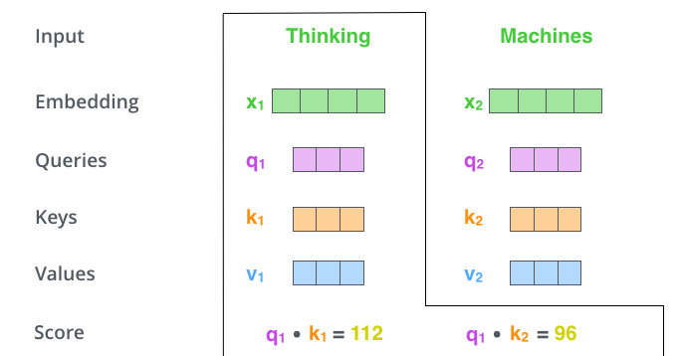
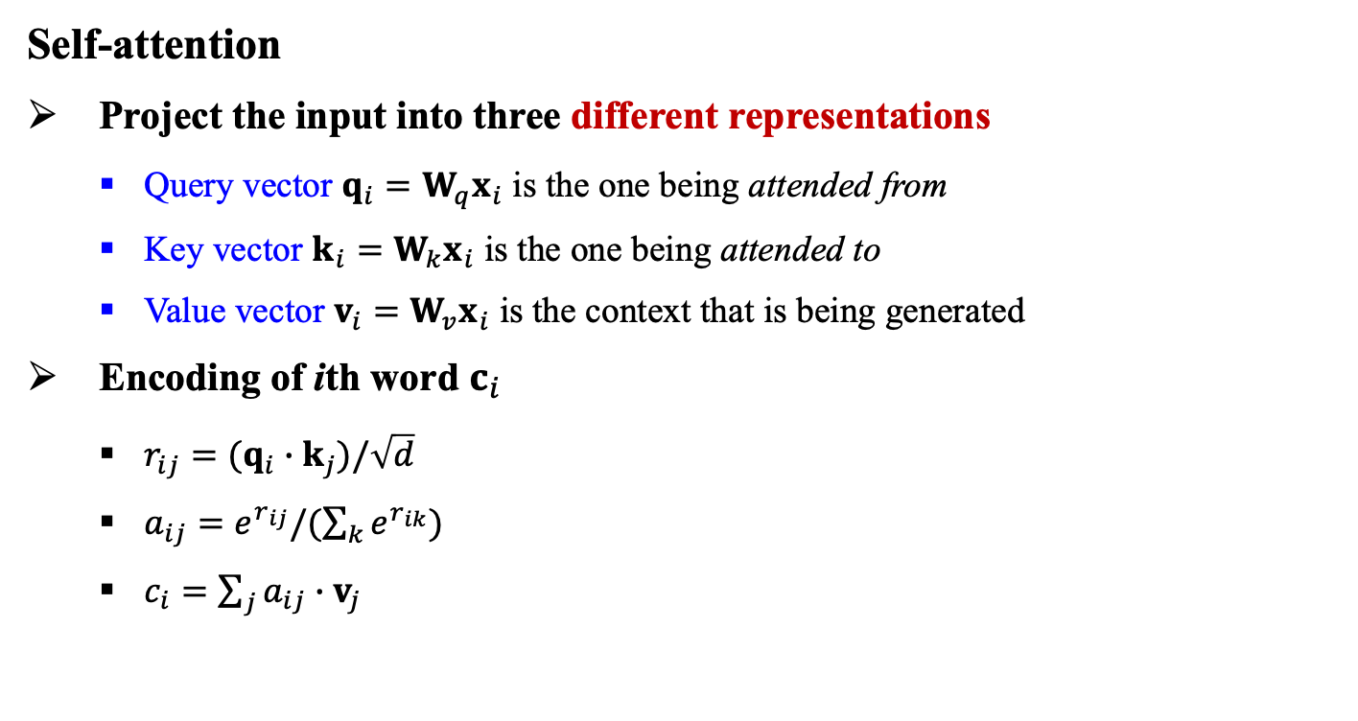
18.9 The Transformer Architecture (2/3)
Self-attention
Project the input into three different representations
Query vector $q_{i}=W_{q}x_{i}$ is the one being attended from
Key vector $k_{i}=W_{k}x_{i}$ is the one being attended to
Value vector $v_{i}=W_{v}x_{i}$ is the context that is being generated
Encoding of ith word $c_{i}$
$r_{ij}=(q_{i}∙k_{j})/\sqrt{d}$
$a_{ij}=e^{r_{ij}}/(\sum_{k}{e^{r_{ik}}})$
$c_{i}=\sum_{j}{a_{ij}∙v_{j}}$

Slide 42
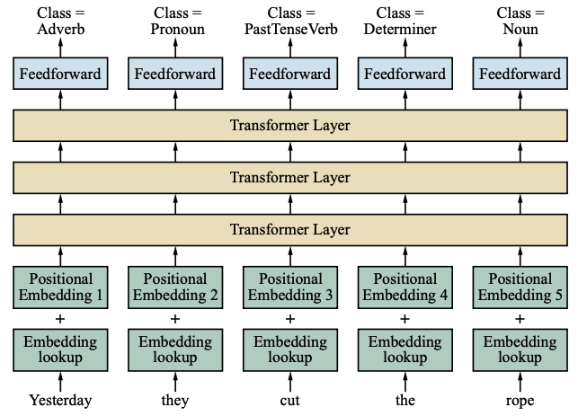
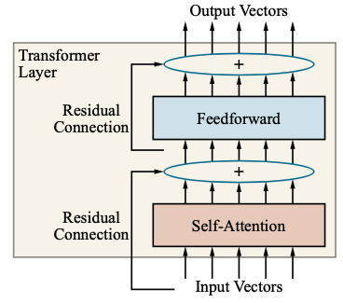
18.9 The Transformer Architecture (3/3)
Transformer architecture
Transformer layer
Positional embedding
Learn a new embedding vector that represents each word position
출처: Stuart J. Russell and Peter Norvig (2021). Artificial Intelligence: A Modern Approach (4rd Edition). Pearson

Slide 43
18.10 Natural Language Tasks

Slide 44
18.10 Natural Language Tasks (1/8)
Text classification
Given a text, decide which of a predefined set of classes it belongs to
e.g. spam detection
Training set:
i) The positive examples (spam) in the spam folder,
ii) The negative examples (ham) in the inbox
Spam: Wholesale Fashion Watches -57% today. Designer watches for cheap …
Spam: You can buy ViagraFr$1.85 All medications at unbeatable prices! …
Ham: The practical significance of hypertree width in identifying more …
Ham: Abstract: We will motivate the problem of social identify clustering …

Slide 45
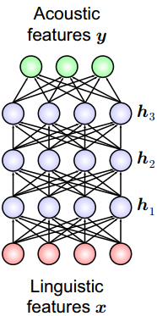
18.10 Natural Language Tasks (2/8)
Speech recognition
transforming spoken sound into text
Text-to-speech
Text to sound
pronounce each word correctly
make the flow of each sentence seem natural, with the right pauses and emphasis
Synthesizing different voices
starting with a choice between a generic male or female voice
allowing for regional dialects
imitating celebrity voices
H. Zen, A. Senior, and M. Schuster. Statistical parametric speech synthesis using deep neural networks. In Proc. ICASSP, pages 7962–7966, 2013.

Slide 46
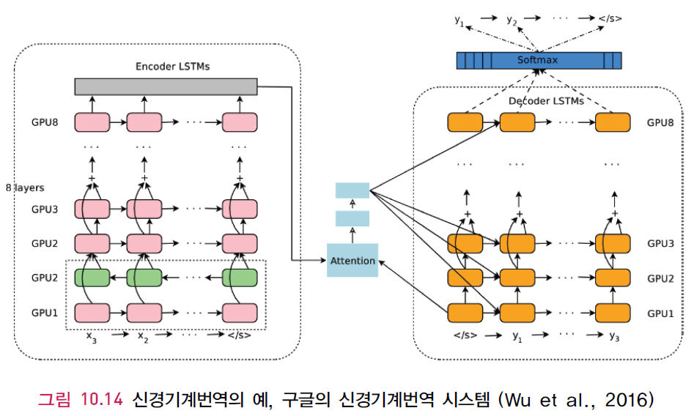
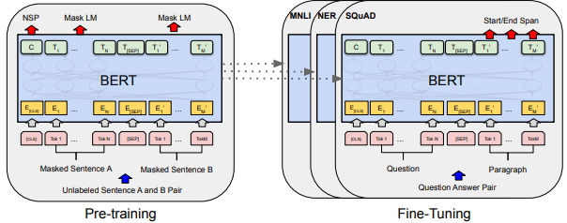
18.10 Natural Language Tasks (3/8)
Machine translation
Transforms text in one language to another
Early 2000s used n-gram models
Recurrent neural sequence-to-sequence models
(Sutskever et al., 2015)
Attention-focusing mechanism of the transformer model
(Vaswani et al., 2018)
출처 : 장병탁, 딥러닝, 홍릉과학출판사, 2017.

Slide 47
18.10 Natural Language Tasks (4/8)
Information extraction
Acquiring knowledge by skimming a text and looking for occurrences of a particular class of objects and for relationships among objects
e.g.
“IBM ThinkBook 970. Our price: $399.00”
➔ {Manufacturer = IBM, Model = ThinkBook 970, Price = $399.00}
“There will be a seminar by Dr. Alan Turing on Friday”
➔ {Event = Seminar, Speaker = Dr. Alan Turing, Date = Friday}
Finite-state machines, Probabilistic models (HMM), Conditional random fields (CRF), Ontology extraction from large corpora, Automated template construction, Machine reading

Slide 48
18.10 Natural Language Tasks (5/8)
Information retrieval
Finding documents that are relevant and important for a given query
c.f.
Question answering: given a query, find the answer (not the documents)
Precision and recall
IR scoring functions: a score of relevancy of document to query
Scoring of web pages: analysis of influential links
PageRank algorithm: Google’s web search algorithm
Hyperlink-induced topic search (HITS) algorithm

Slide 49
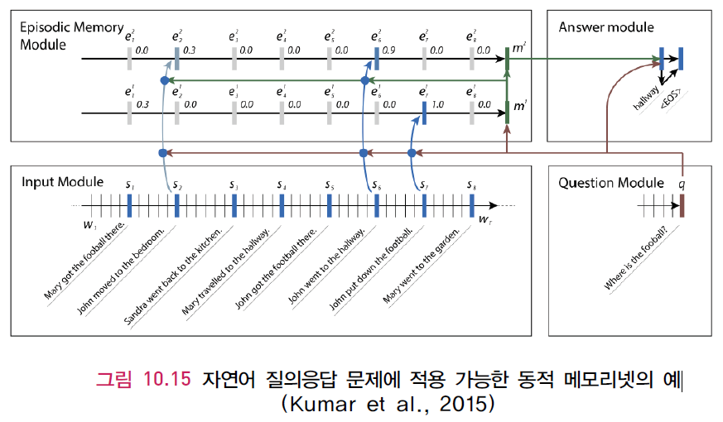
18.10 Natural Language Tasks (6/8)
Question answering
출처 : 장병탁, 딥러닝, 홍릉과학출판사, 2017.

Slide 50
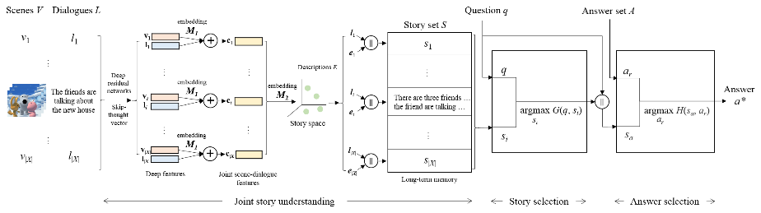
18.10 Natural Language Tasks (7/8)
Visual Question Answering (VQA)
Concatenation of scene description and dialogue
Attention-based scoring function
Embedding into dialogue space
Add video modality
Store into long-term memory
Encoding using deep models
Retrieve scene description
Video story understanding module
Story selection module
Answer selection module

Slide 51
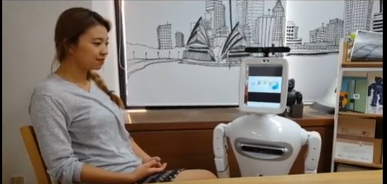
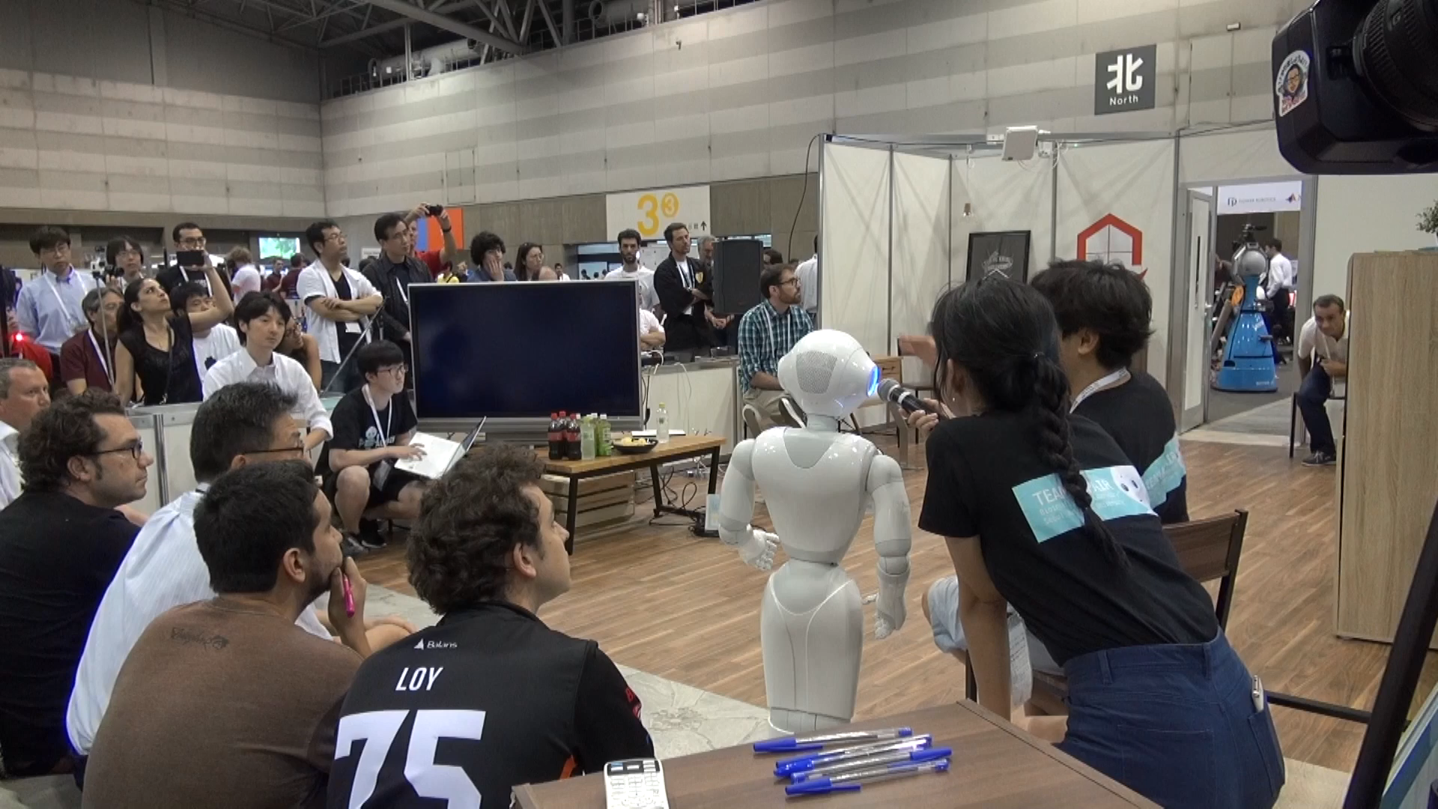
18.10 Natural Language Tasks (8/8)
Dialogue Systems
Pororobot: Visual dialogue (vision + language)
https://www.youtube.com/watch?v=OtkEkLpjs3s&t=1s
[Ha et al., AAAI-2015], [Kim et al., IJCAI-2017], [Lee et al., NIPS-2018]

Slide 52
Summary
Probabilistic language models based on n-grams recover a surprising amount of information about a language. They can perform well on such diverse tasks as language identification, spelling correction, sentiment analysis, genre classification, and namedentity recognition.
These language models can have millions of features, so preprocessing and smoothing the data to reduce noise is important.
In building a statistical language system, it is best to devise a model that can make good use of available data, even if the model seems overly simplistic.
Word embeddings can give a richer representation of words and their similarities.
To capture the hierarchical structure of language, phrase structure grammars (and in particular, context-free grammars) are useful. The probabilistic context-free grammar (PCFG) formalism is widely used, as is the dependency grammar formalism.
It is convenient to augment a grammar to handle issues such as subject–verb agreement and pronoun case, and to represent information at the level of words rather than just at the level of categories.
Semantic interpretation can also be handled by an augmented grammar. We can learn a semantic grammar from a corpus of questions paired either with the logical form of the question, or with the answer.
Natural language is complex and difficult to capture in a formal grammar.

